Slide 1
Hibernate. JPA. Transaction Management

Slide 2
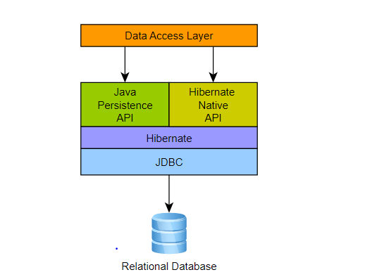
Hibernate

Slide 3
Hibernate
@Configuration @ComponentScan(basePackages = “kz") @EnableTransactionManagement public class AppConfig { private static Logger logger = LoggerFactory.getLogger(AppConfig.class); @Bean public DataSource dataSource() { try { EmbeddedDatabaseBuilder dbBuilder = new EmbeddedDatabaseBuilder(); return dbBuilder.setType(EmbeddedDatabaseType.H2) .addScripts("classpath:sql/schema.sql", "classpath:sql/test-data.sql").build(); } catch (Exception e) { logger.error("Embedded DataSource bean cannot be created!", e); return null; } } private Properties hibernateProperties() { Properties hibernateProp = new Properties(); hibernateProp.put("hibernate.dialect", "org.hibernate.dialect.H2Dialect"); hibernateProp.put("hibernate.format_sql", true); hibernateProp.put("hibernate.use_sql_comments", true); hibernateProp.put("hibernate.show_sql", true); hibernateProp.put("hibernate.max_fetch_depth", 3); hibernateProp.put("hibernate.jdbc.batch_size", 10); hibernateProp.put("hibernate.jdbc.fetch_size", 50); return hibernateProp; } @Bean public SessionFactory sessionFactory() throws IOException { LocalSessionFactoryBean sessionFactoryBean = new LocalSessionFactoryBean(); sessionFactoryBean.setDataSource(dataSource()); sessionFactoryBean.setPackagesToScan("com.apress.prospring5.ch7.entities"); sessionFactoryBean.setHibernateProperties(hibernateProperties()); sessionFactoryBean.afterPropertiesSet(); return sessionFactoryBean.getObject(); } @Bean public PlatformTransactionManager transactionManager() throws IOException { return new HibernateTransactionManager(sessionFactory()); } }

Slide 4
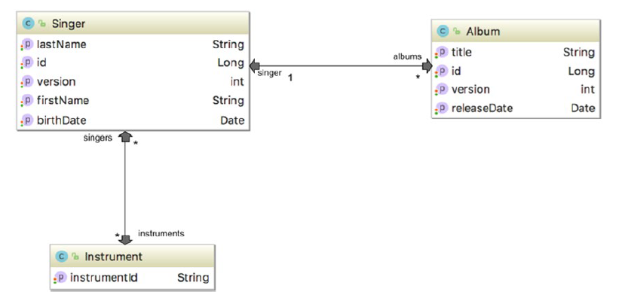
Hibernate

Slide 5
Hibernate
@Entity @Table(name = "singer") public class Singer implements Serializable { private Long id; private String firstName; private String lastName; private Date birthDate; private int version; public void setId(Long id) { this.id = id; } @Id @GeneratedValue(strategy = IDENTITY) @Column(name = "ID") public Long getId() { return this.id; } @Version @Column(name = "VERSION") public int getVersion() { return version; } @Column(name = "FIRST_NAME") public String getFirstName() { return this.firstName; } @Column(name = "LAST_NAME") public String getLastName() { return this.lastName; } @Temporal(TemporalType.DATE) @Column(name = "BIRTH_DATE") public Date getBirthDate() { return birthDate; } public void setFirstName(String firstName) { this.firstName = firstName; } public void setLastName(String lastName) { this.lastName = lastName; } ….. }

Slide 6
Hibernate
@Entity @Table(name = "album") public class Album extends AbstractEntity { @Column private String title; @Temporal(TemporalType.DATE) @Column(name = "RELEASE_DATE") private Date releaseDate; ……
@Entity @Table(name = "instrument") public class Instrument implements Serializable { @Id @Column(name = "INSTRUMENT_ID") private String instrumentId;
…….

Slide 7
Hibernate
@Entity @Table(name = "album") public class Album extends AbstractEntity { @Column private String title; @Temporal(TemporalType.DATE) @Column(name = "RELEASE_DATE") private Date releaseDate; @ManyToOne @JoinColumn(name = "SINGER_ID") private Singer singer;
……
public class Singer extends AbstractEntity { public static final String FIND_SINGER_BY_ID = "Singer.findById"; public static final String FIND_ALL_WITH_ALBUM = "Singer.findAllWithAlbum"; @Column(name = "FIRST_NAME") private String firstName; @Column(name = "LAST_NAME") private String lastName; @Temporal(TemporalType.DATE) @Column(name = "BIRTH_DATE") private Date birthDate; @OneToMany(mappedBy = "singer", cascade=CascadeType.ALL, orphanRemoval=true) private Set<Album> albums = new HashSet<>(); @ManyToMany @JoinTable(name = "singer_instrument", joinColumns = @JoinColumn(name = "SINGER_ID"), inverseJoinColumns = @JoinColumn(name = "INSTRUMENT_ID")) private Set<Instrument> instruments = new HashSet<>();
@Entity @Table(name = "instrument") public class Instrument implements Serializable { @Id @Column(name = "INSTRUMENT_ID") private String instrumentId; @ManyToMany @JoinTable(name = "singer_instrument", joinColumns = @JoinColumn(name = "INSTRUMENT_ID"), inverseJoinColumns = @JoinColumn(name = "SINGER_ID")) private Set<Singer> singers = new HashSet<>();

Slide 8
Hibernate
@Transactional @Repository("singerDao") public class SingerDaoImpl implements SingerDao { private static final Log logger = LogFactory.getLog(SingerDaoImpl.class); private SessionFactory sessionFactory; @Transactional(readOnly = true) public List<Singer> findAll() { return sessionFactory.getCurrentSession().createQuery("from Singer s").list(); } @Transactional(readOnly = true) public List<Singer> findAllWithAlbum() { return sessionFactory.getCurrentSession(). getNamedQuery("Singer.findAllWithAlbum").list(); } @Transactional(readOnly = true) public Singer findById(Long id) { return (Singer) sessionFactory.getCurrentSession(). getNamedQuery("Singer.findById"). setParameter("id", id).uniqueResult(); } public Singer save(Singer singer) { sessionFactory.getCurrentSession().saveOrUpdate(singer); logger.info("Singer saved with id: " + singer.getId()); return singer; } public void delete(Singer singer) { sessionFactory.getCurrentSession().delete(singer); logger.info("Singer deleted with id: " + singer.getId()); }
@Configuration @EnableTransactionManagement @PropertySource("classpath:db/jdbc.properties") public class AdvancedConfig { ……… @Value("${driverClassName}") private String driverClassName; @Value("${url}") private String url; ……… @Bean public SessionFactory sessionFactory() { return new LocalSessionFactoryBuilder(dataSource()) .scanPackages(“kz") .addProperties(hibernateProperties()) .buildSessionFactory(); }

Slide 9
JPA 2

Slide 10
JPA 2
@Configuration @EnableTransactionManagement @ComponentScan(basePackages = {“kz"}) public class JpaConfig { private static Logger logger = LoggerFactory.getLogger(JpaConfig.class); @Bean public DataSource dataSource() { try { EmbeddedDatabaseBuilder dbBuilder = new EmbeddedDatabaseBuilder(); return dbBuilder.setType(EmbeddedDatabaseType.H2) .addScripts("classpath:db/schema.sql", "classpath:db/test-data.sql").build(); } catch (Exception e) { logger.error("Embedded DataSource bean cannot be created!", e); return null; } } @Bean public PlatformTransactionManager transactionManager() { return new JpaTransactionManager(entityManagerFactory()); } @Bean public JpaVendorAdapter jpaVendorAdapter() { return new HibernateJpaVendorAdapter(); }
@Bean public Properties hibernateProperties() { Properties hibernateProp = new Properties(); hibernateProp.put("hibernate.dialect", "org.hibernate.dialect.H2Dialect"); hibernateProp.put("hibernate.format_sql", true); hibernateProp.put("hibernate.use_sql_comments", true); hibernateProp.put("hibernate.show_sql", true); hibernateProp.put("hibernate.max_fetch_depth", 3); hibernateProp.put("hibernate.jdbc.batch_size", 10); hibernateProp.put("hibernate.jdbc.fetch_size", 50); return hibernateProp; } @Bean public EntityManagerFactory entityManagerFactory() { LocalContainerEntityManagerFactoryBean factoryBean = new LocalContainerEntityManagerFactoryBean(); factoryBean.setPackagesToScan(“kz"); factoryBean.setDataSource(dataSource()); factoryBean.setJpaProperties(hibernateProperties()); factoryBean.setJpaVendorAdapter(jpaVendorAdapter()); factoryBean.afterPropertiesSet(); return factoryBean.getNativeEntityManagerFactory(); } }

Slide 11
JPA 2
@Configuration @EnableTransactionManagement @ComponentScan(basePackages = {“kz"}) @EnableJpaRepositories(basePackages = {“kz"}) public class DataJpaConfig { private static Logger logger = LoggerFactory.getLogger(DataJpaConfig.class); @Bean public DataSource dataSource() {
…………
@Entity @Table(name = "singer") @NamedQueries({ @NamedQuery(name=Singer.FIND_ALL, query="select s from Singer s"), @NamedQuery(name=Singer.FIND_SINGER_BY_ID, query="select distinct s from Singer s " + "left join fetch s.albums a " + "left join fetch s.instruments i " + "where s.id = :id"), @NamedQuery(name=Singer.FIND_ALL_WITH_ALBUM, query="select distinct s from Singer s " + "left join fetch s.albums a " + "left join fetch s.instruments i") }) @SqlResultSetMapping( name="singerResult", entities=@EntityResult(entityClass=Singer.class) ) public class Singer implements Serializable { public static final String FIND_ALL = "Singer.findAll"; public static final String FIND_SINGER_BY_ID = "Singer.findById"; public static final String FIND_ALL_WITH_ALBUM = "Singer.findAllWithAlbum";
……………

Slide 12
JPA 2
@Entity @Table(name = "singer") @NamedQueries({ @NamedQuery(name=Singer.FIND_ALL, query="select s from Singer s"), @NamedQuery(name=Singer.FIND_SINGER_BY_ID, query="select distinct s from Singer s " + "left join fetch s.albums a " + "left join fetch s.instruments i " + "where s.id = :id"), @NamedQuery(name=Singer.FIND_ALL_WITH_ALBUM, query="select distinct s from Singer s " + "left join fetch s.albums a " + "left join fetch s.instruments i") }) @SqlResultSetMapping( name="singerResult", entities=@EntityResult(entityClass=Singer.class) ) public class Singer implements Serializable { public static final String FIND_ALL = "Singer.findAll"; public static final String FIND_SINGER_BY_ID = "Singer.findById"; public static final String FIND_ALL_WITH_ALBUM = "Singer.findAllWithAlbum"; @Id @GeneratedValue(strategy = IDENTITY) @Column(name = "ID") private Long id;
@Service("jpaSingerService") @Repository @Transactional @SuppressWarnings("unchecked") public class SingerServiceImpl implements SingerService { final static String ALL_SINGER_NATIVE_QUERY = "select id, first_name, last_name, birth_date, version from singer"; private Log log = LogFactory.getLog(SingerServiceImpl.class); @PersistenceContext private EntityManager em; @Transactional(readOnly=true) @Override public List<Singer> findAll() { List<Singer> singers = em.createNamedQuery(Singer.FIND_ALL, Singer.class).getResultList(); return singers; } @Transactional(readOnly=true) @Override public List<Singer> findAllWithAlbum() { List<Singer> singers = em.createNamedQuery(Singer.FIND_ALL_WITH_ALBUM, Singer.class).getResultList(); return singers; }

Slide 13
JPA 2
@Service("springJpaSingerService") @Transactional public class SingerServiceImpl implements SingerService { @Autowired private SingerRepository singerRepository; @Transactional(readOnly=true) public List<Singer> findAll() { return Lists.newArrayList(singerRepository.findAll()); } @Transactional(readOnly=true) public List<Singer> findByFirstName(String firstName) { return singerRepository.findByFirstName(firstName); } @Transactional(readOnly=true) public List<Singer> findByFirstNameAndLastName( String firstName, String lastName) { return singerRepository.findByFirstNameAndLastName( firstName, lastName); } }
public interface SingerRepository extends CrudRepository<Singer, Long> { List<Singer> findByFirstName(String firstName); List<Singer> findByFirstNameAndLastName(String firstName, String lastName); }
@NoRepositoryBean public interface CrudRepository<T, ID extends Serializable> extends Repository<T, ID> { long count(); void delete(ID id); void delete(Iterable<? extends T> entities); void delete(T entity); void deleteAll(); boolean exists(ID id); Iterable<T> findAll(); T findOne(ID id); Iterable<T> save(Iterable<? extends T> entities); T save(T entity); }

Slide 14
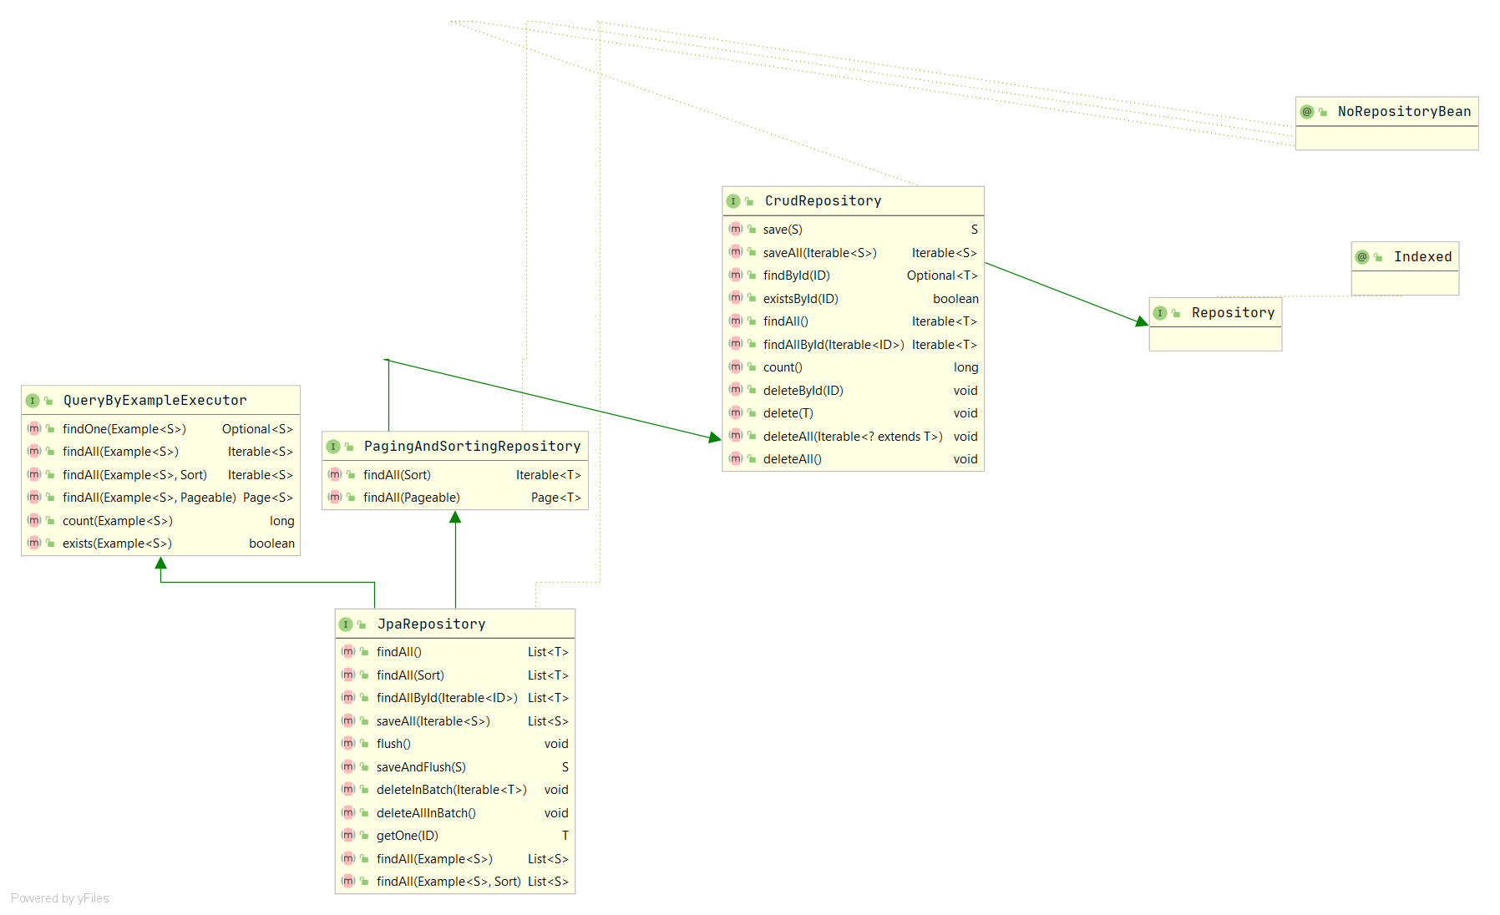
JPA 2

Slide 15
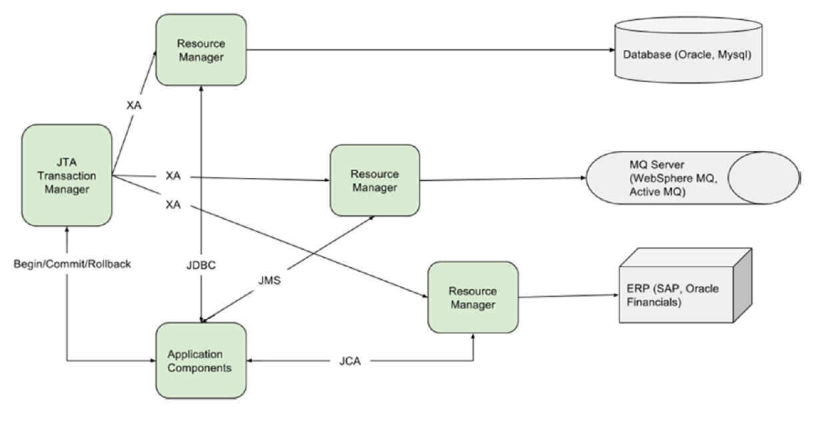
Transaction Management
ISOLATION_DEFAULT
ISOLATION_READ_UNCOMMITTED
ISOLATION_READ_COMMITTED
ISOLATION_REPEATABLE_READ
ISOLATION_SERIALIZABLE

Slide 16
Transaction Management
@Configuration @EnableTransactionManagement @ComponentScan(basePackages = “kz") public class ServicesConfig { @Autowired EntityManagerFactory entityManagerFactory; @Bean public PlatformTransactionManager transactionManager() { return new JpaTransactionManager(entityManagerFactory); } }
@Service("singerService") @Transactional public class SingerServiceImpl implements SingerService { @Autowired private SingerRepository singerRepository; @Override @Transactional(readOnly = true) public List<Singer> findAll() { return Lists.newArrayList(singerRepository.findAll()); } @Override @Transactional(readOnly = true) public Singer findById(Long id) { return singerRepository.findById(id).get(); } @Override public Singer save(Singer singer) { return singerRepository.save(singer); } @Override @Transactional(propagation = Propagation.NEVER) public long countAll() { return singerRepository.countAllSingers(); } }
public interface SingerRepository extends CrudRepository<Singer, Long> { @Query("select count(s) from Singer s") Long countAllSingers(); }

